Slide 1
Stacks:
Stacks is a linear type of data structure that follows the LIFO (Last-In-First-Out) principle and allows insertion and deletion operations from one end of the stack data structure, that is top.
Implementation of the stack can be done by contiguous memory which is an array, and non-contiguous memory which is a linked list.
Stack plays a vital role in many applications.
Real-life examples of a stack are a deck of cards, piles of books, piles of money, and many more.

Slide 2
Some key points related to stack:
It is called as stack because it behaves like a real-world stack, piles of books, etc.
A Stack is an abstract data type with a pre-defined capacity, which means that it can store the elements of a limited size.
It is a data structure that follows some order to insert and delete the elements, and that order can be LIFO (LAST IN FIRST OUT) or FILO (FIRST IN LAST OUT).

Slide 3
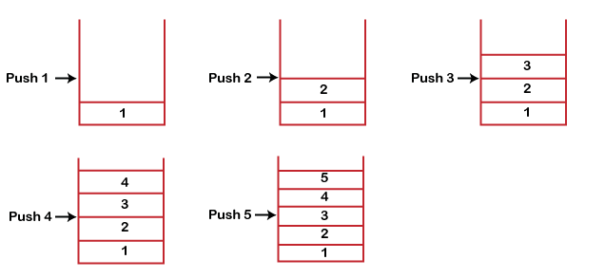
Working of Stack:
Stack works on the LIFO pattern.
Inserting a new element in the stack is termed a push operation.
Removing or deleting elements from the stack is termed pop operation

Slide 4
Standard Stack Operations:
push (): When we insert an element in a stack then the operation is known as a push. If the stack is full then the overflow condition occurs.
pop (): When we delete an element from the stack, the operation is known as a pop. If the stack is empty means that no element exists in the stack, this state is known as an underflow state.
is Empty (): It determines whether the stack is empty or not.
Is Full (): It determines whether the stack is full or not.'
peek (): It returns the element at the given position.
count (): It returns the total number of elements available in a stack.
change (): It changes the element at the given position.
display (): It prints all the elements available in the stack.

Slide 5
PUSH operation:
The steps involved in the PUSH operation is given below:
Before inserting an element in a stack, we check whether the stack is full.
If we try to insert the element in a stack, and the stack is full, then the overflow condition occurs.
When we initialize a stack, we set the value of top as -1 to check that the stack is empty.
When the new element is pushed in a stack, first, the value of the top gets incremented, i.e., top=top+1, and the element will be placed at the new position of the top.
The elements will be inserted until we reach the max size of the stack.

Slide 6
Push operation includes various steps:
Step 1: First, check whether or not the stack is full
Step 2: If the stack is complete, then exit
Step 3: If not, increment the top by one
Step 4: Insert a new element where the top is pointing
Step 5: Success

Slide 7
The algorithm of the push operation is:
Begin push: stack, item
If the stack is complete(Full), return null
end if
top ->top+1;
stack[top] <- item
end

Slide 8
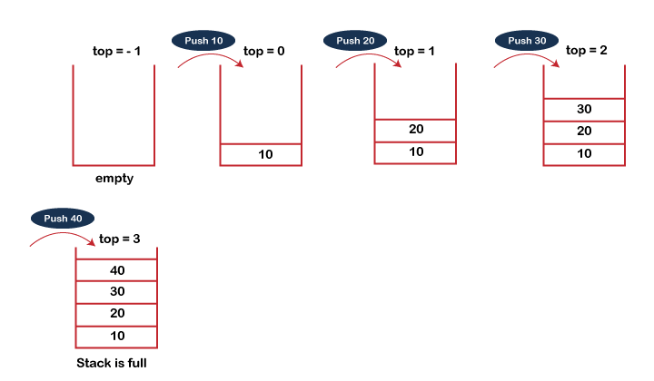

Slide 9
POP operation:
The steps involved in the POP operation is given below:
Before deleting the element from the stack, we check whether the stack is empty.
If we try to delete the element from the empty stack, then the underflow condition occurs.
If the stack is not empty, we first access the element which is pointed by the top
Once the pop operation is performed, the top is decremented by 1, i.e., top=top-1.

Slide 10
Pop operation includes various steps:
Step 1: First, check whether or not the stack is empty
Step 2: If the stack is empty, then exit
Step 3: If not, access the topmost data element
Step 4: Decrement the top by one
Step 5: Success

Slide 11
The algorithm of the pop operation:
Begin pop: stack
if the stack is empty
return null
end if
item -> stack[top] ;
Top -> top - 1;
Return item;
end

Slide 12
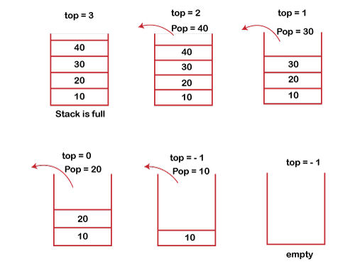

Slide 13
Peek Operation:
The algorithm of a peek operation is:
begin to peek
return stack[top];
End
The implementation of the peek operation is:
int peek()
{
return stack[top];
}

Slide 14
The algorithm of the isEmpty() function:
begin
if
topless than 1
return true
else
return false
else if
end

Slide 15
Types of Stacks:
Register Stack:
This type of stack is also a memory element present in the memory unit and can handle a small amount of data only.
The height of the register stack is always limited as the size of the register stack is very small compared to the memory.
Memory Stack:
This type of stack can handle a large amount of memory data.
The height of the memory stack is flexible as it occupies a large amount of memory data.

Slide 16
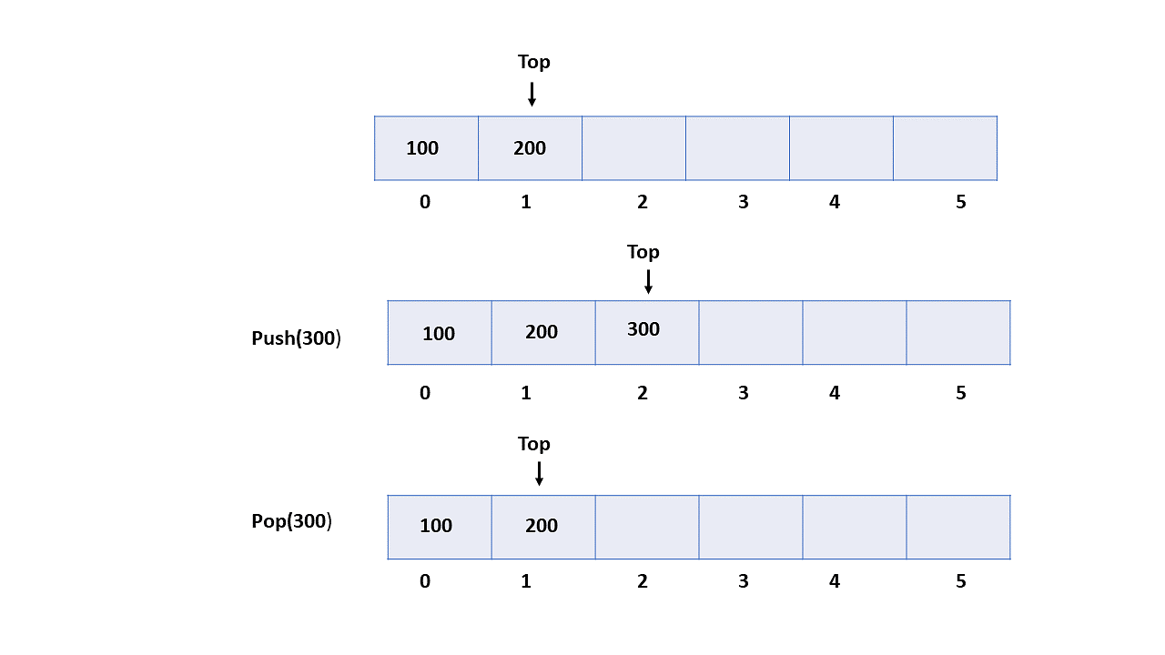
Implementation of Stack:
There are two ways to implement a stack
Using array
Using linked list
Implementing Stack using Arrays:
In array implementation, the stack is formed using an array. All the operations are performed using arrays.

Slide 17
Advantages of array implementation:
Easy to implement.
Memory is saved as pointers are not involved.
Disadvantages of array implementation:
It is not dynamic.
It doesn’t grow and shrink depending on needs at runtime.

Slide 18
Implementing Stack using Linked List:
Every new element is inserted as a top element in the linked list implementation of stacks in data structures.
That means every newly inserted element is pointed to the top.
Whenever you want to remove an element from the stack, remove the node indicated by the top, by moving the top to its previous node in the list.

Slide 19
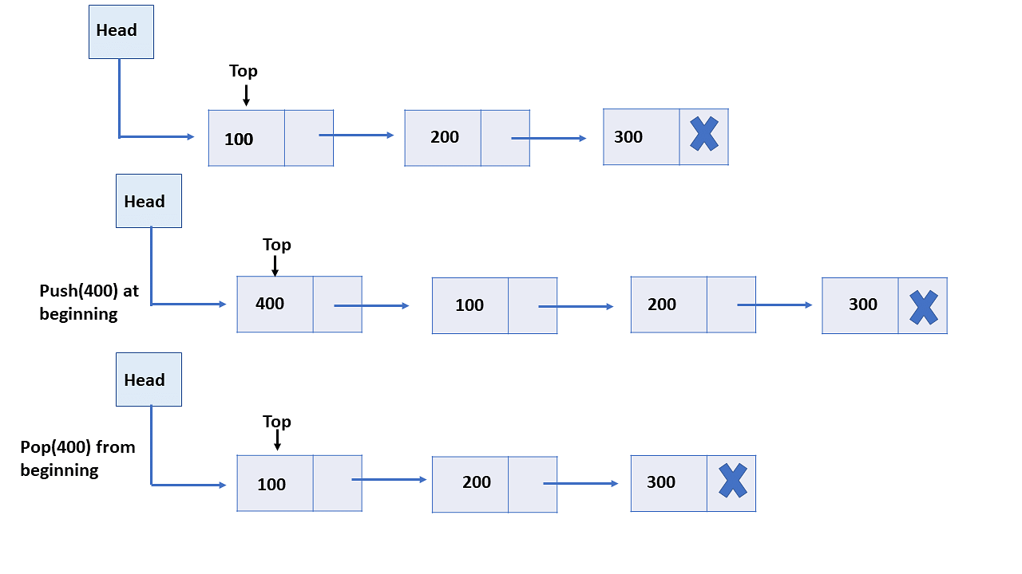

Slide 20
Advantages of Linked List implementation:
The linked list implementation of a stack can grow and shrink according to the needs at runtime.
It is used in many virtual machines like JVM.
Stacks are more secure and reliable as they do not get corrupted easily.
Stack cleans up the objects automatically.
Disadvantages of Linked List implementation:
Requires extra memory due to the involvement of pointers.
Random accessing is not possible in stack.
The total size of the stack must be defined before.
If the stack falls outside the memory it can lead to abnormal termination.

Slide 21
Application of Stack in Data Structures:
Expression Evaluation and Conversion
Backtracking
Function Call
Parentheses Checking
String Reversal
Syntax Parsing
Memory Management

Slide 22
Storing two stacks into one Array:
To store two stacks into one array, you can divide the array into two parts and allocate each part to a separate stack.
One way to do this is to allocate the first half of the array to one stack and the second half to the other stack.
Here's an example implementation in Python:
class TwoStacks:
def __init__(self, n):
self.n = n
self.array = [None] * n
self.top1 = -1
self.top2 = n

Slide 23
def push1(self, item):
if self.top1 < self.top2 - 1:
self.top1 += 1
self.array[self.top1] = item
else:
print("Stack Overflow")
return
def push2(self, item):
if self.top1 < self.top2 - 1:
self.top2 -= 1
self.array[self.top2] = item
else:
print("Stack Overflow")
return

Slide 24
def pop1(self):
if self.top1 == -1:
print("Stack Underflow")
return None
else:
item = self.array[self.top1]
self.top1 -= 1
return item
def pop2(self):
if self.top2 == self.n:
print("Stack Underflow")
return None

Slide 25
else:
item = self.array[self.top2]
self.top2 += 1
return item
In the above example, the TwoStacks class initializes the array with a length n and initializes two pointers top1 and top2 to track the top of each stack.
The push1 method pushes an item onto the first stack, push2 pushes an item onto the second stack, pop1 pops an item off the first stack, and pop2 pops an item off the second stack.

Slide 26
To push an item onto a stack, the method first checks if there is enough space in the array.
If there is, it increments the top pointer and sets the item at the top of the stack.
If there is not enough space, it prints an error message and returns.
To pop an item off a stack, the method first checks if the stack is empty.
If it is, it prints an error message and returns.
If it is not empty, it retrieves the item at the top of the stack, decrements the top pointer, and returns the item.

